Slide 1

GOVERNMENT COLLEGE OF ENGINEERING AND TEXTILE TECHNOLOGY, BERHAMPORE
STEGANOGRAPHY USING PYTHON
MENTOR : MR. PROTON SARKAR
GROUP MEMBERS: 1. TARPON DEY
2. VIVEK DAS
3. DEEPYAMAN GHOSH
4. DEVKANT GORAI
5. SOHAM BHATTACHARJEE
DEPARTMENT: COMPUTER SCIENCE AND ENGINEERING
PAPER NAME: PROJECT III
PAPER CODE: PROJ-CS881

Slide 2
WHAT IS STEGANOGRAPHY?
Steganography is the practice of concealing information within another message or physical object to avoid detection. Steganography can be used to hide virtually any type of digital content, including text, image, video, or audio content. That hidden data is then extracted at its destination.

Slide 3
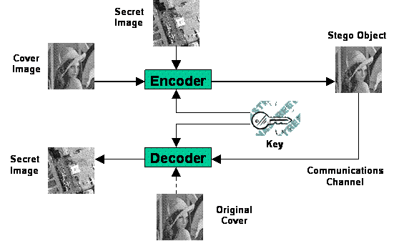

GENERAL MODEL OF STEGANOGRAPHY

Slide 4
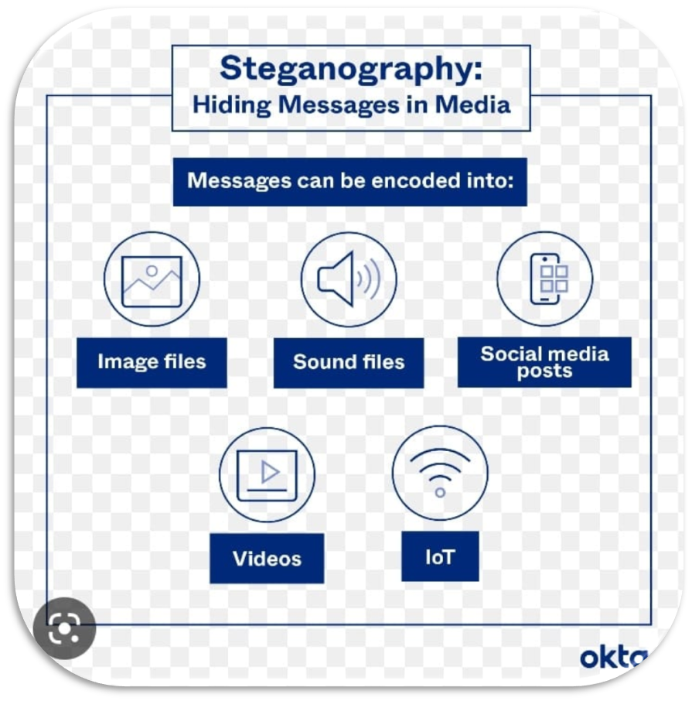
HOW STEGANOGRAPHY WORKS
Steganography is an ancient technique (known from the Antiquity) for hiding information.
A Digital Message (the secret) can be hidden within
digital images
audio files
video files
… or even other text messages by storing the secret information within inessential lines of code (bytes) that don't alter the look or sound of the original file.

Slide 5
PROCESS IN STEGANOGRAPHY
The data to be concealed is compressed and hidden within another file.
The first step is to find a file which will be used to hide the message (also called a carrier or a container.)
The next step is to embed the message one wants to hide within the carrier using a steganographic technique.
Two different techniques commonly used for embedding are:
Replace the least significant bit of each byte in the [carrier] with a single bit for the hidden message.
Select certain bytes in which to embed the message using a random number generator; resampling the bytes to pixel mapping to preserve color scheme, in the case of an image...; hiding information in the coefficients of the discrete cosine, fractal or wavelet transform of an image; and applying mimic functions that adapt bit pattern to a given statistical distribution."

Slide 6
LSB IMAGE STEGANOGRAPHY
LSB Steganography is an image steganography technique in which messages are hidden inside an image by replacing each pixel’s least significant bit with the bits of the message to be hidden.
To understand better, let’s consider a digital image to be a 2D array of pixels. Each pixel contains values depending on its type and depth. We will consider the most widely used modes — RGB(3x8-bit pixels, true-color) and RGBA(4x8-bit pixels, true-color with transparency mask). These values range from 0–255, (8-bit values).

Slide 7
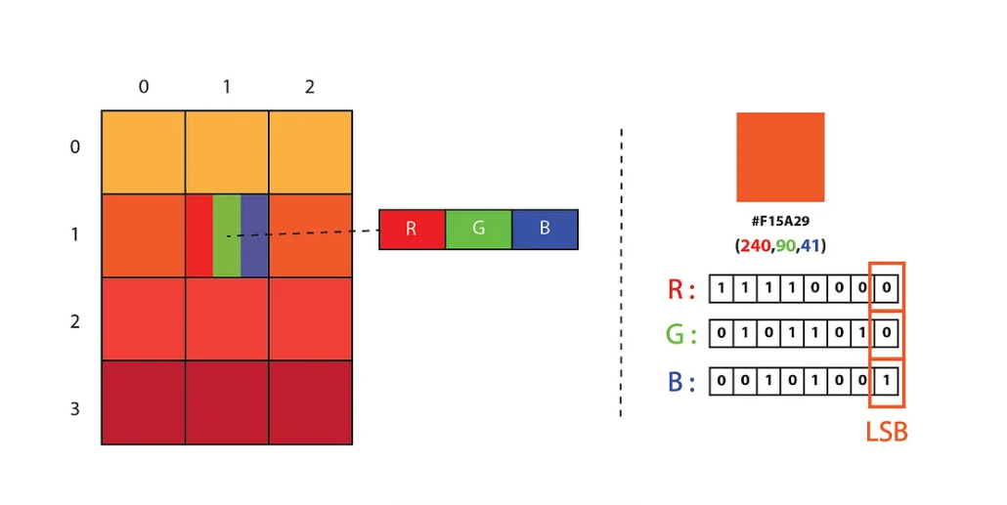
Representation of Image as a 2D Array of RGB Pixels

Slide 8
LSB IMAGE STEGANOGRAPHY IMPLEMENTATION
We can convert the message into decimal values and then into binary, by using the ASCII Table. Then, we iterate over the pixel values one by one, after converting them to binary, we replace each least significant bit with that message bits in a sequence.
To decode an encoded image, we simply reverse the process. Collect and store the last bits of each pixel then split them into groups of 8 and convert it back to ASCII characters to get the hidden message.

Slide 9
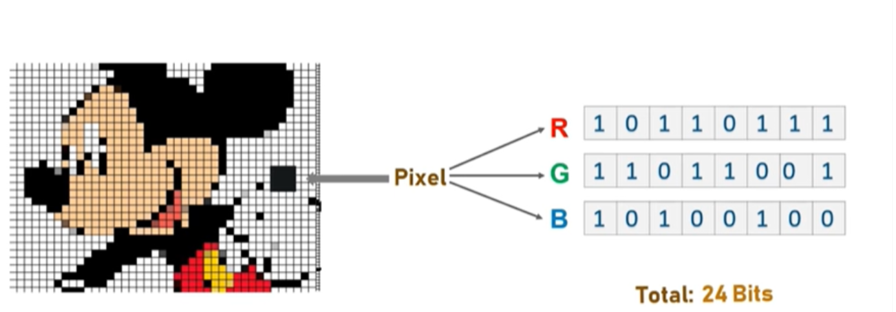
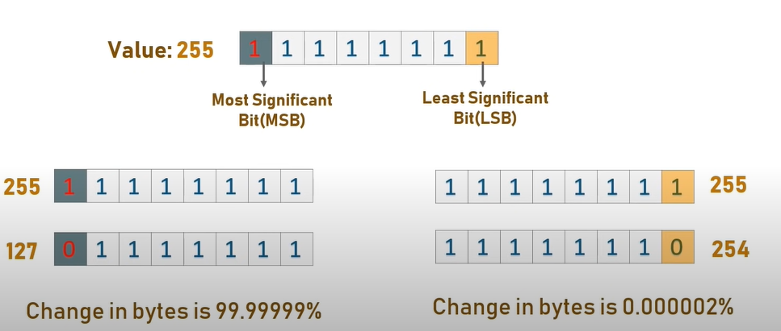
LSB

Slide 10
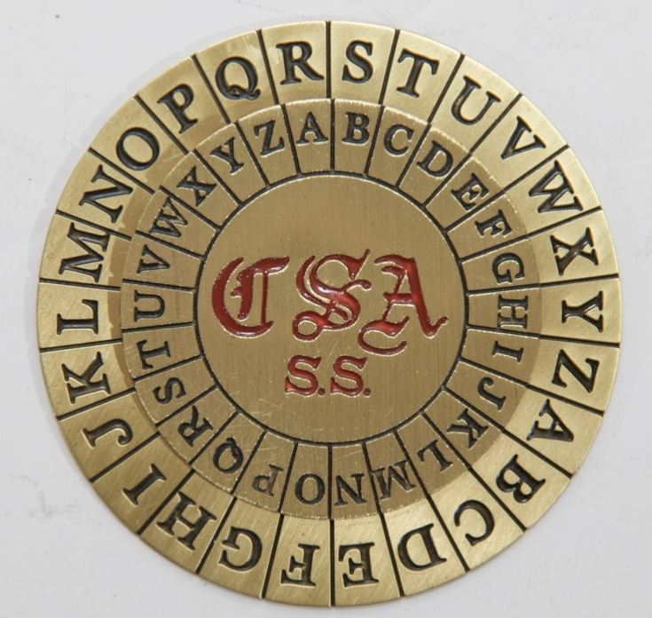
Vigenère Cipher
Used as a field cipher during the American Civil War

Slide 11
A Vigenère cipher is difficult to crack using brute-force because each letter in a message could be encoded as any of the 26 letters. Because the encoding of the message depends on the keyword used, a given message could be encoded in 26^k ways, where k is the length of the keyword. For example, if we only know that a message is encoded with a word of 7 letters, then it could be encoded in 26^7≈8 billion ways!

Slide 12
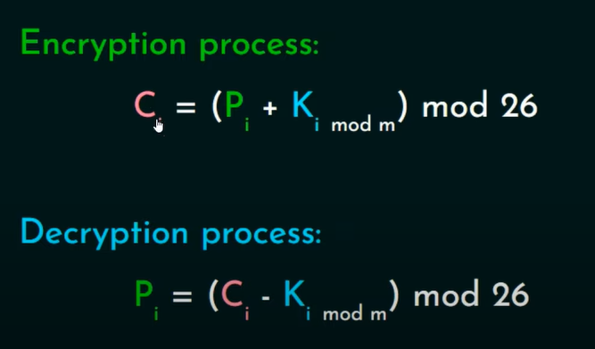
m=length of key
P_{i} = i^{th} character in Word
C_{i}=i^{th} character in Codeword

Slide 13
ZIGZAG SCANNING
For the purpose of more security we used Zigzag scanning method which is gained by Steganography technique. In this method the image pixels are used to hide the secret message by converting the secret message into bits. This Zigzag scanning uses patterns for hiding the secret message bits. This pattern will be only known to sender and receiver. By using this pattern, the receiver can retrieve his secret message.

Slide 14
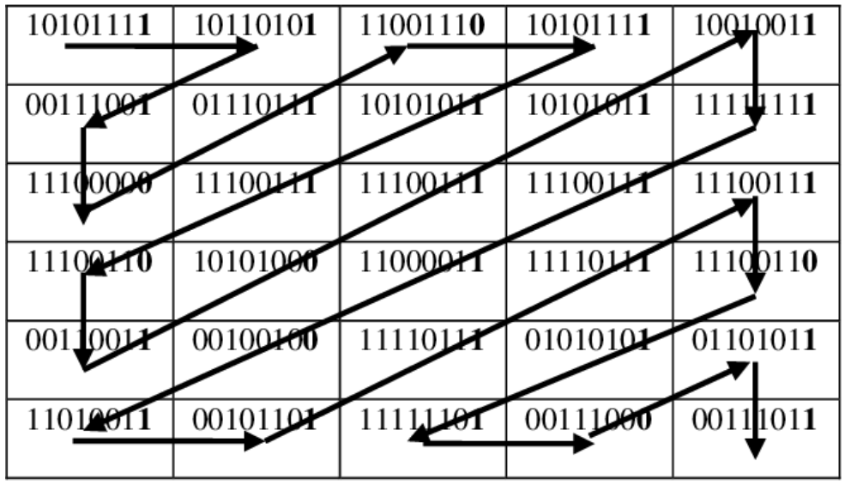
Zig zag scanning

Slide 15
TEXT IN IMAGE STEGANOGRAPHY
Text in Image Steganography is the process of embedding text in images such that its existence cannot be detected by Human Visual System (HVS) and is known only to sender and receiver.
Image steganography is implemented using Hue-Saturation-Intensity (HSI) color space based on Least Significant Bit (LSB). This method transforms the image from RGB color space to Hue-Saturation-Intensity (HSI) color space and then embeds secret data inside the Intensity Plane (I-Plane) and transforms it back to RGB color model after embedding.

Slide 16
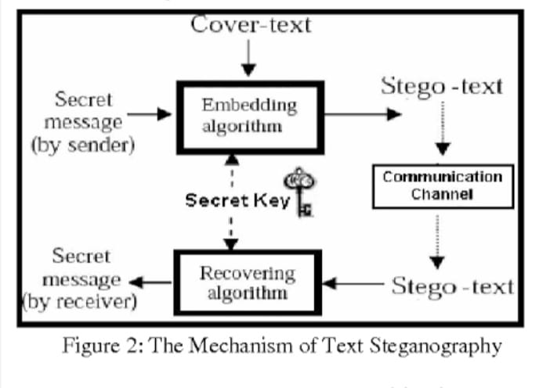

MECHANISM AND KEY FEATURES
Image is used as cover object for secret text or messages
Generally, the techniques in this method modify the image pixels for hiding secret information.
Images are considered to be the best cover objects/carriers for hiding information because it contains large amount of redundant bits.
Text steganography is preferable for simple communication where less memory is needed.

Slide 17

EXAMPLE OF TEXT IN IMAGE STEGANOGRAPHY
SECRET MESSAGE
ENCRYPTED DATA
Dear Susan:
I can wait no longer I want to see you now please say that you will come.
San...
IMPLENTATION- Here , a secret message in the form of a text is encrypted and stored in the form of an image.

Slide 18
IMAGE IN IMAGE STEGANOGRAPHY
Image Steganography is the process of hiding secret image in some image. Here, we will hide one image inside another and convert it into another image and then extract back both the images from the previous image.
The idea behind image-based Steganography is very simple. Images are composed of digital data (pixels), which describes what’s inside the picture, usually the colors of all the pixels, since we know every image is made up of pixels and every pixel contains 3-values (red, green, blue).

Slide 19
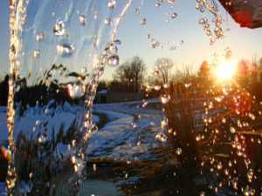

EXAMPLE
OUTPUT -
1. After encryption
INPUT-
An algorithm is to be written for encrypting/hiding IMAGE 1 in IMAGE 2 and finding out the OUTPUT for both
1.After encryption
2.After decryption
2. After Decryption
IMAGE 1
IMAGE 2
IMAGE 1
IMAGE 2

Slide 20
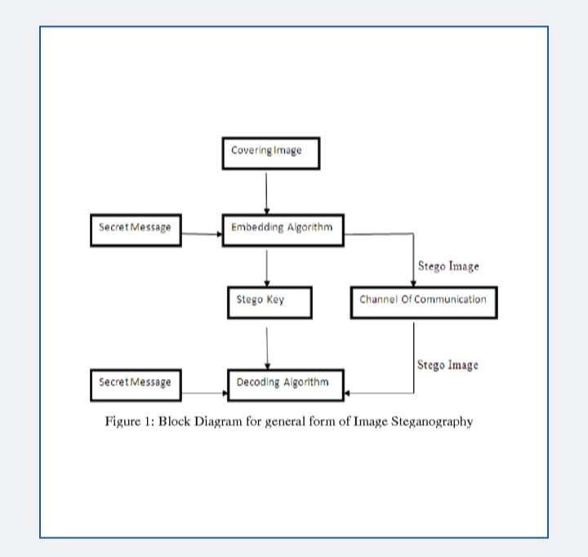

MECHANISM AND KEY FEATURES
Image steganography is performed for images and the concerning data is also decrypted to retrieve the message image.
The intended secret message does not attract attention to itself as an object of scrutiny. Plainly visible encrypted messages, no matter how unbreakable they are, arouse interest and may in themselves be incriminating in countries in which encryption is illegal.
Image to image steganography is more discreet when we want to send a secret information. On the other hand, the hidden message is easier to extract.

Slide 21
APPLICATIONS OF STEGANOGRAPHY
Steganography is applicable to, but not limited to, the following areas.
Confidential communication and secret data storing
Protection of data alterations.
Access control system for digital content distribution
Media Database systems
Digital Watermarking − Digital watermarking is the procedure of embedding data into a digital signal in a way that is complex to delete. The signal can be audio, pictures or video.
Visible Watermarking − In visible watermarking, the information is visible in the picture or video. Generally, the information is text or a logo which recognizes the owner of the media. When a television broadcaster insert its logo to the corner of transmitted video, and this is also a visible watermark.
Invisible Watermarking − In this invisible watermarking, information is inserted as digital data to audio, picture or video, but it cannot be perceived as such (although it can be possible to recognize that some amount of data is hidden).

Slide 22
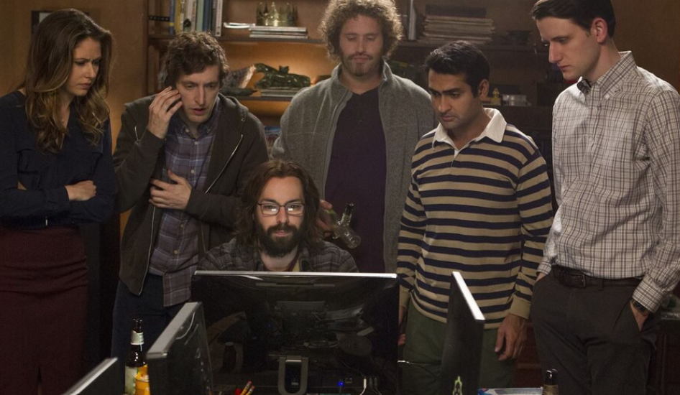
Steps to encode and decode a text inside an image

Slide 23
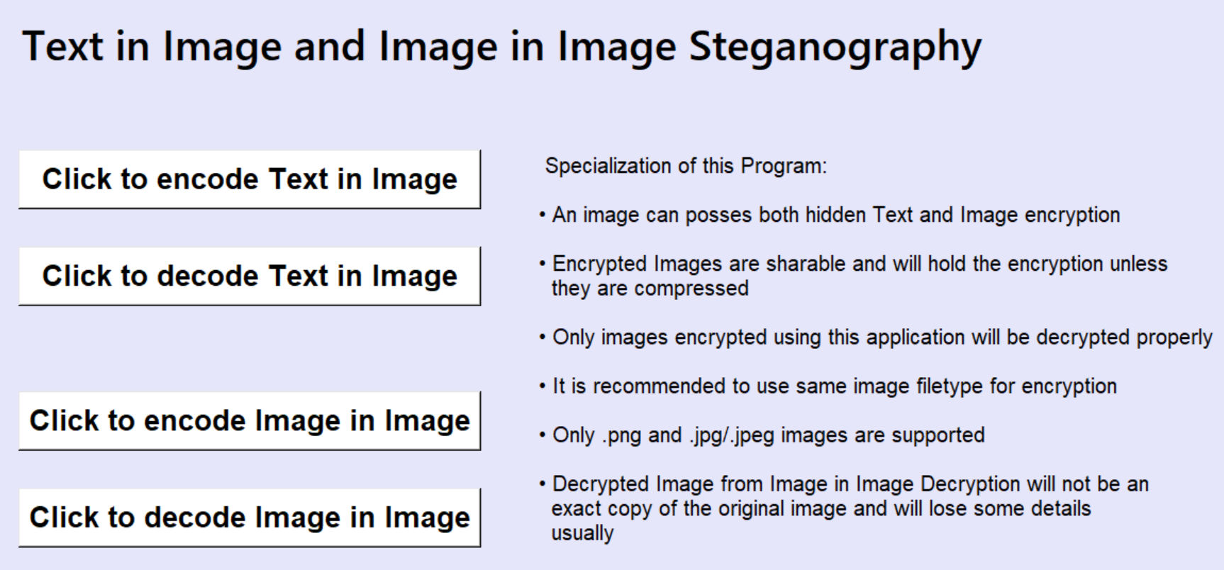
Step - 1
Click to encode a text in image

Slide 24
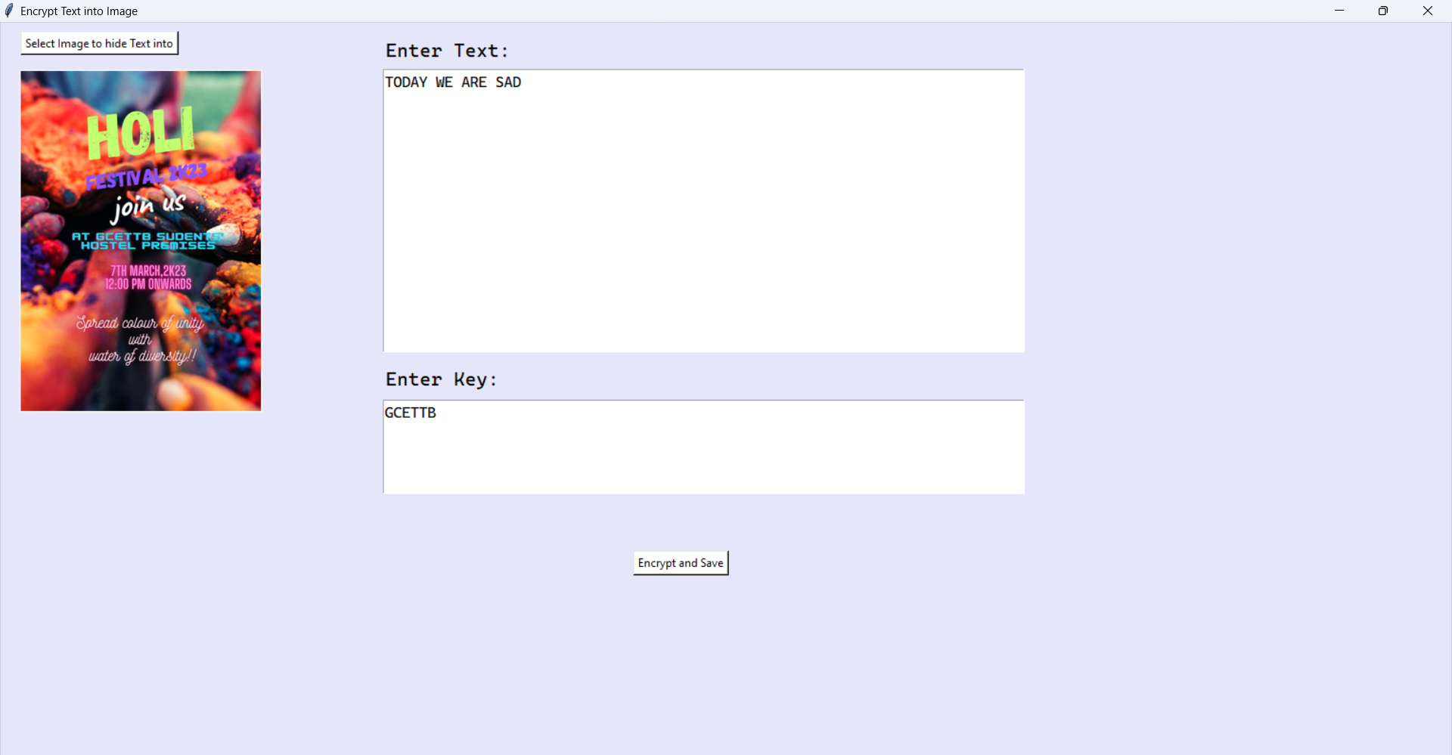
STEP 2
Select the image into which the text is to be encrypted
Enter the text to be encrypted
Enter the SECURITY KEY

Slide 25
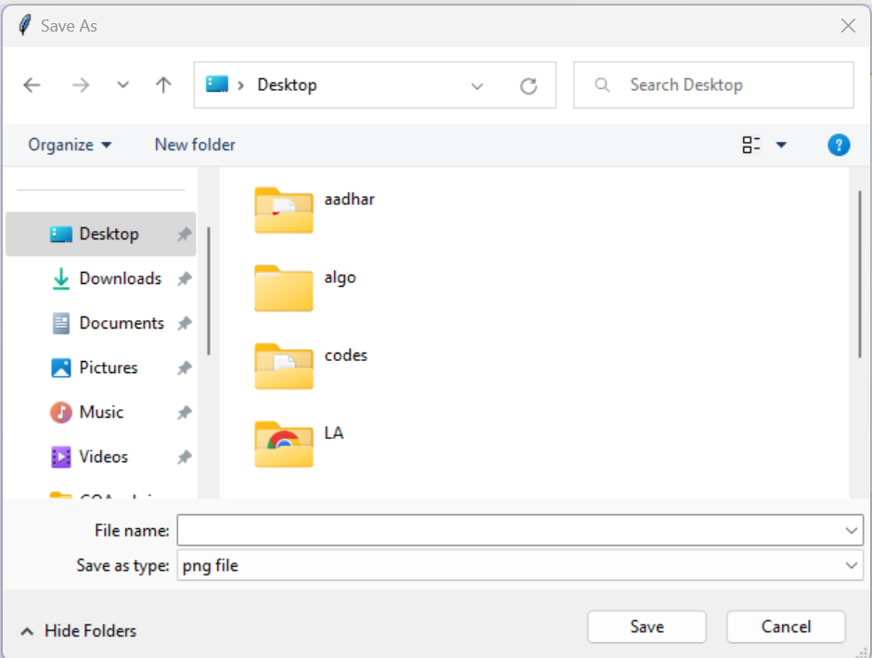
Step -3
Type file name and select location where you want to save the encoded TEXT

Slide 26

STEP 4
Text has been encrypted sucessfully

Slide 27
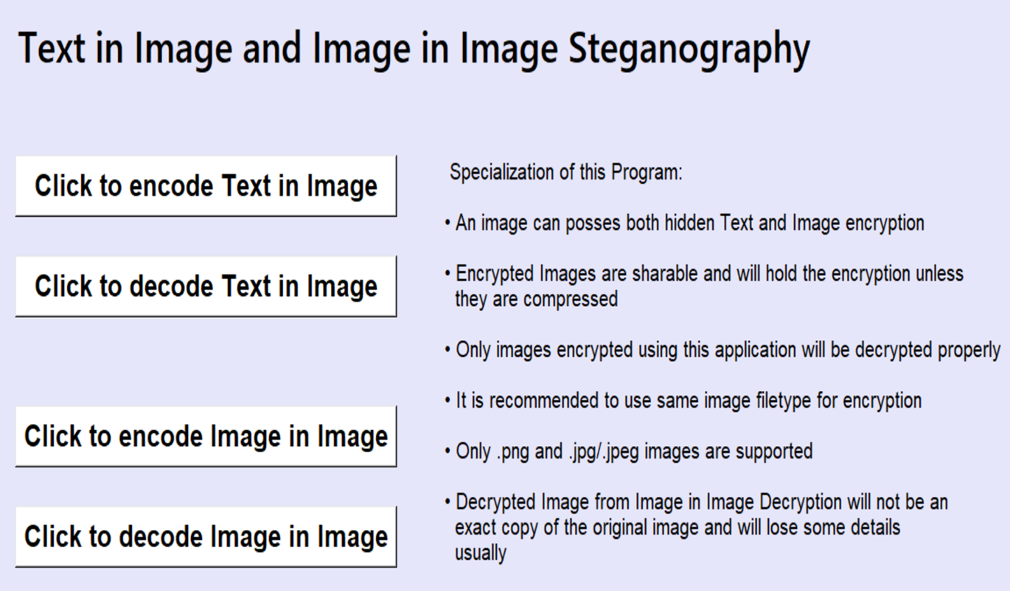
STEP 5
Click to decode text from image

Slide 28
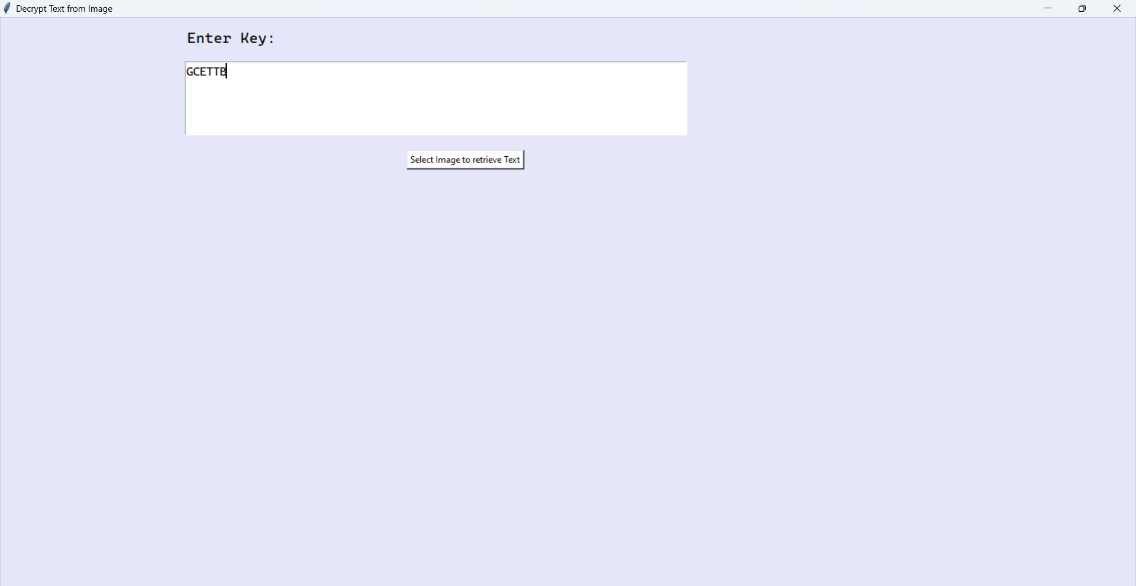
STEP 6
Enter the security key
Select the image to retrieve the text

Slide 29
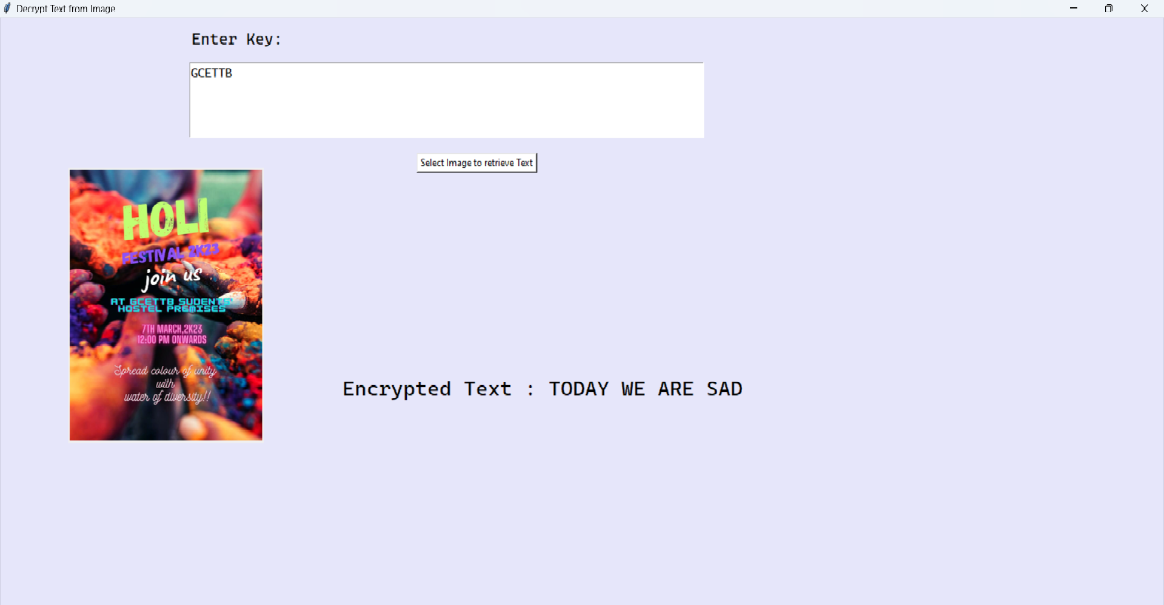
DECRYPTED TEXT FROM IMAGE

Slide 30

Steps to encode and decode an image from an image

Slide 31
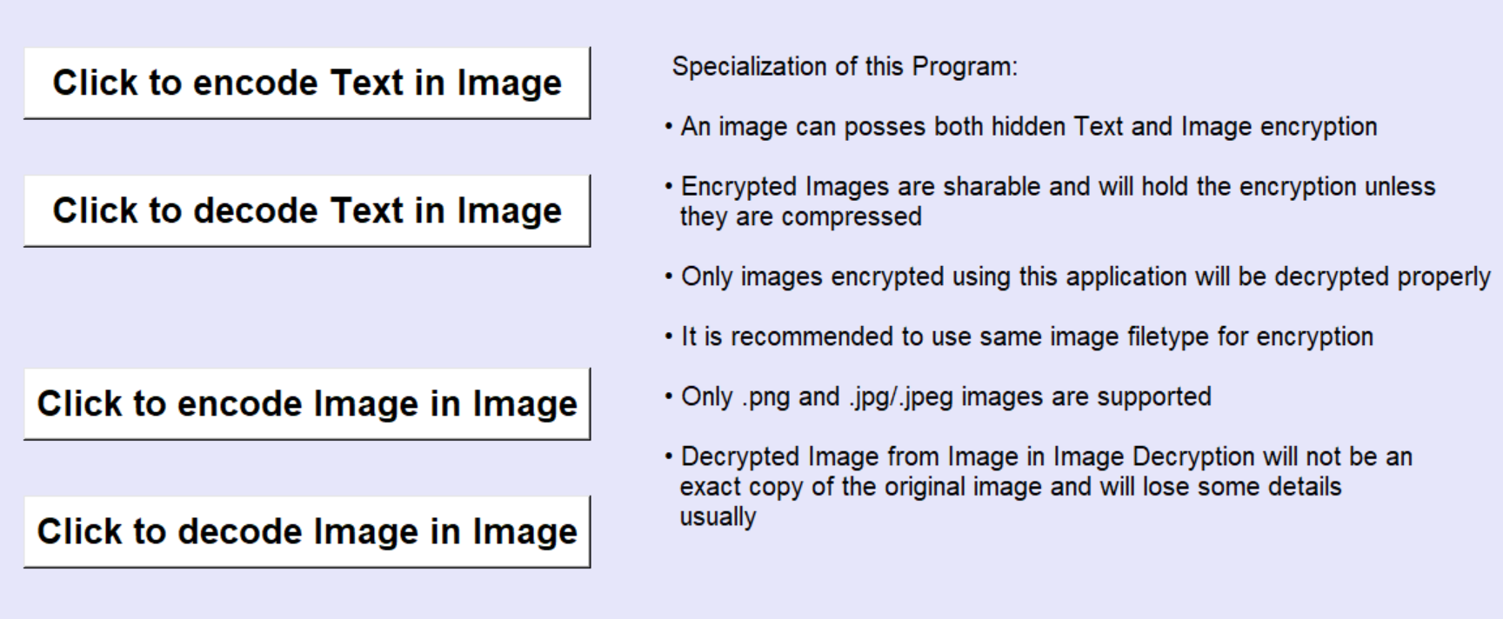
Step -1
Select image in which you want to encode an image

Slide 32
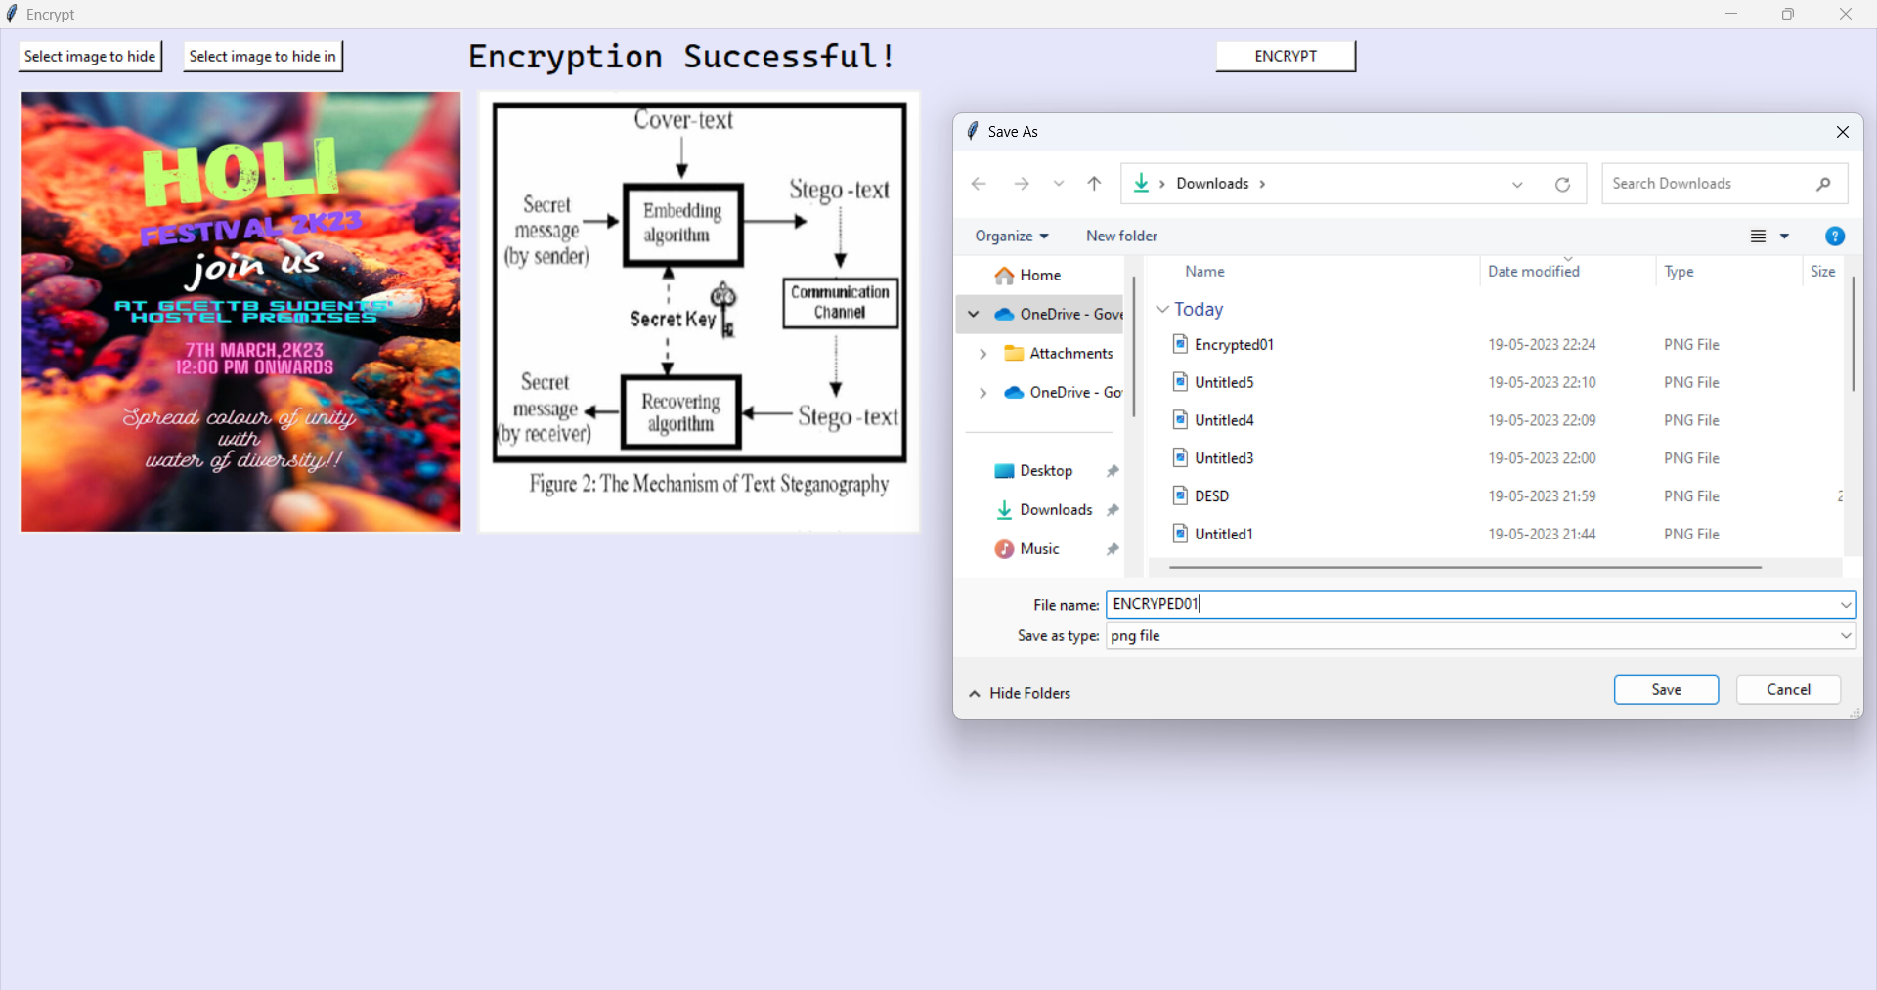
STEP 2
Select image to Hide
Select the cover image
Type file name and select location where you want to save the encoded image

Slide 33

Click to decode the encrypted image

Slide 34

Step -2
Select image from which you want to decode text/image

Slide 35
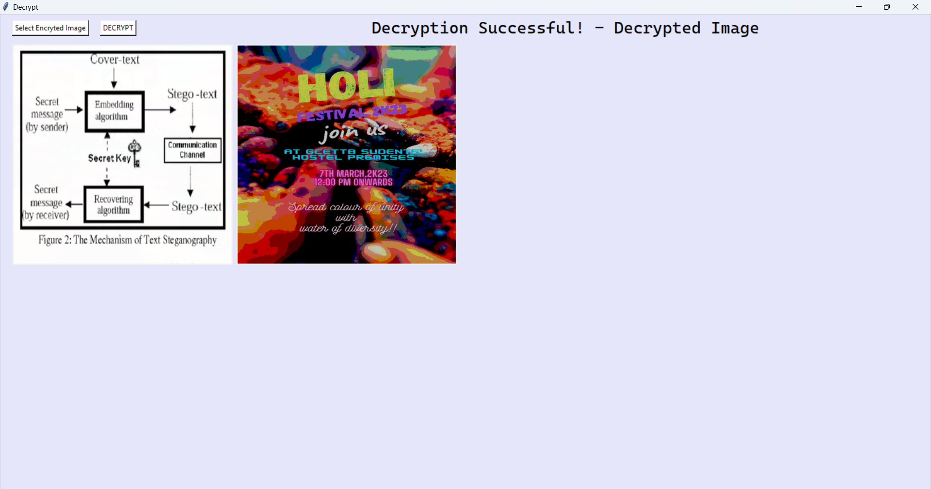
Step -3
Press this button to decrypt image
Encoded image inside left image

Slide 36
Summary
This presentation discusses the basic fundamentals of image steganography, implementations of image steganography in real world and some terminologies required to understand image steganography. Also, implementation of LSB steganography and how image compression takes a major part in it.

Slide 37
The Conclusion
After successful completion of the project we learned :
• There are many different ways we can exchange image secretly in this day.
• How an image is processed by a computer.
• Different ways to hide message inside images.
• How we can understand the fundamentals of different techniques and use them to achieve our goal.
• Importance of compression of images.

Slide 38
Appendix – List of Useful Websites
1. Advanced JPEG Steganography and Detection by John Ortiz. https://www.youtube.com/watch?v=BQPkRlbVFEs
2. Secrets Hidden in Images (Steganography) – Computerphile. https://www.youtube.com/watch?v=TWEXCYQKyDc
3. Image Compressing using Discrete Cosine Transform in Matlab- Part 1 https://www.youtube.com/watch?v=UU0tLHsMaOA
4. The Tickle Trunk: Guide to JPEG-89 Compression. http://cgjennings.ca/toybox/hjpeg/

Slide 39
THE END

